Slide 1
Algorithms
Definitions:
An algorithm is any well-defined computational procedure that takes some value, or set of values, as input and produces some value, or set of values, as output.
An algorithm is thus a sequence of computational steps that transform the input into the output.

Slide 2
Algorithm Efficiency
Efficiency: Algorithms that solve the same problem can differ enormously in their efficiency.
We would like to select the most efficient algorithm for solving a given problem.
Notes:
The analysis of algorithms is the area of computer science that provides tools for contrasting the efficiency of different methods of solution.
The analysis concerns itself primarily with significant differences in efficiency, and not clever coding tricks that may save a little bit of time at the cost of code readability.
The efficient use of both time and memory is important. Computer scientists use similar techniques to analyze an algorithm’s time and space efficiency. For our purposes, we are primarily concerned with time efficiency

Slide 3
Algorithm Efficiency
How do you compare the time efficiency of two algorithms that solve the same problem? One approach is to implement both algorithms in Java and run the programs. This approach has at least three fundamental difficulties:
How are the algorithms coded? You should not compare implementations, because they are sensitive to factors such as programming style that tend to cloud the issue of which algorithm is inherently more efficient.
What computer should you use? One computer may simply be much faster than the other, so clearly you should use the same computer for both programs. You should compare the efficiency of the algorithms independently of a particular computer.
What data should the programs use? There is always the danger that you will select instances of the problem for which one of the algorithms runs uncharacteristically fast. Any analysis of efficiency must be independent of specific data.
Notes:
The analysis of algorithms is the area of computer science that provides tools for contrasting the efficiency of different methods of solution.
The analysis concerns itself primarily with significant differences in efficiency, and not clever coding tricks that may save a little bit of time at the cost of code readability.
The efficient use of both time and memory is important. Computer scientists use similar techniques to analyze an algorithm’s time and space efficiency. For our purposes, we are primarily concerned with time efficiency

Slide 4
Algorithm Efficiency
space or space complexity: Determine the approximate memory required to solve a problem of size n.
time or computational/time complexity: Determine the approximate number of operations required to solve a problem of size n.
We can compare:
Worst Case: maximum number of operations
Average Case: mean number of operations assuming an input probability distribution
Notes:
Worst Case: maximum number of operations
Average Case: mean number of operations assuming an input probability distribution

Slide 5
Space Efficiency
Space efficiency: Space efficiency is usually an all-or-nothing proposition; either we have enough space in our computer’s memory to run a program implementing a specific algorithm, or we do not. If we have enough, we’re OK; if not, we can’t run the program at all.
However, if resources are scarce or we want to preserve them for other routines, we may choose an algorithm that takes a little longer but uses less space.
Notes:
Consequently, analysis of the space requirements of a program tend to be pretty simple and straightforward.

Slide 6
Space efficiency
Space requirements set a minimum lower bound on the time efficiency of the problem.
Suppose that our data structure is a single-dimensioned array with n = 100 elements in it. Let’s say that the first step in our algorithm is to execute a loop that just reads and copies values into each of the 100 elements. Then our algorithm must take at least 100 iterations of the loop.
So the running time of our algorithm is at least n, just from setting up (initializing) our data structure! Here n is the size of data (number of data elements).

Slide 7
Time Efficiency
Time efficiency: When we talk about the efficiency of an algorithm, we usually mean the step requirements of the algorithm.
How may steps would it take a program executing this algorithm to solve the problem?
What is an efficient algorithm?

Slide 8
Example
Consider our array-based implementation of the List ADT with the reference-based implementation.
In the array-based implementation, the list.get(n) method could access the nth item in a list directly in one step, because the item is stored in items[n-1].
A reference-based call to list.get(n), however, must traverse the list from its beginning until the nth node is reached, and so would require n steps

Slide 9
Example
Node curr = head; // Constant time
while (curr != null) { // Number of nodes + 1
System.out.println(curr.item); // Constant time (each)
curr = curr.next; // Constant time (each)
} // end while
Assuming a linked list of n nodes, these statement require n + 1 assignments, n + 1 comparisons, and n write operations.
If each assignment, comparison, and write operation requires, respectively, a, c, and w time units, the statements require (n + 1) * (a + c) + n * w time units.
Thus, the time required to write n nodes is proportional to n.
This should make sense intuitively: It takes longer to display, or traverse, a linked list of 100 items than it does a linked list of 10 items.

Slide 10
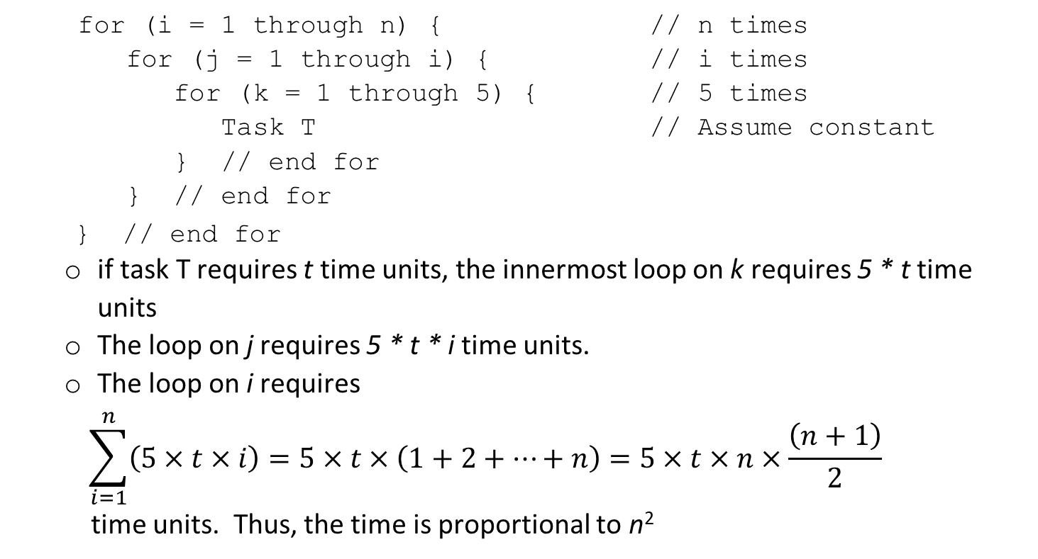
Example
for (i = 1 through n) { // n times
for (j = 1 through i) { // i times
for (k = 1 through 5) { // 5 times
Task T // Assume constant
} // end for
} // end for
} // end for
if task T requires t time units, the innermost loop on k requires 5 * t time units
The loop on j requires 5 * t * i time units.
The loop on i requires
$$\sum_{i=1}^{n}{\left(5×t×i\right)=5×t×\left(1+2+…+n\right)=5×t×n×\frac{\left(n+1\right)}{2}}$$
time units. Thus, the time is proportional to n²

Slide 11
Algorithm analysis
Only three types of flow control are needed to execute any computable algorithm: sequential, selection, and repetition (Bohm and Giacopini).
Sequential and selection statements usually require one step each.
Repetition statements include both explicit iteration (such as for, while, and repeat loops) and recursive function calls. (e.g: recurrence relations…)
To determine the running time of repetition statements, we have to analyze what is going on in the loops.
That is we identify and count a basic operation for the algorithm
1966.

Slide 12
Asymptotic notations
Asymptotic efficiency of algorithms
How does the running time of an algorithm increase as the input increases in size without bound?
Asymptotic notations
Define sets of functions that satisfy certain criteria and use these to characterize time and space complexity of algorithms

Slide 13
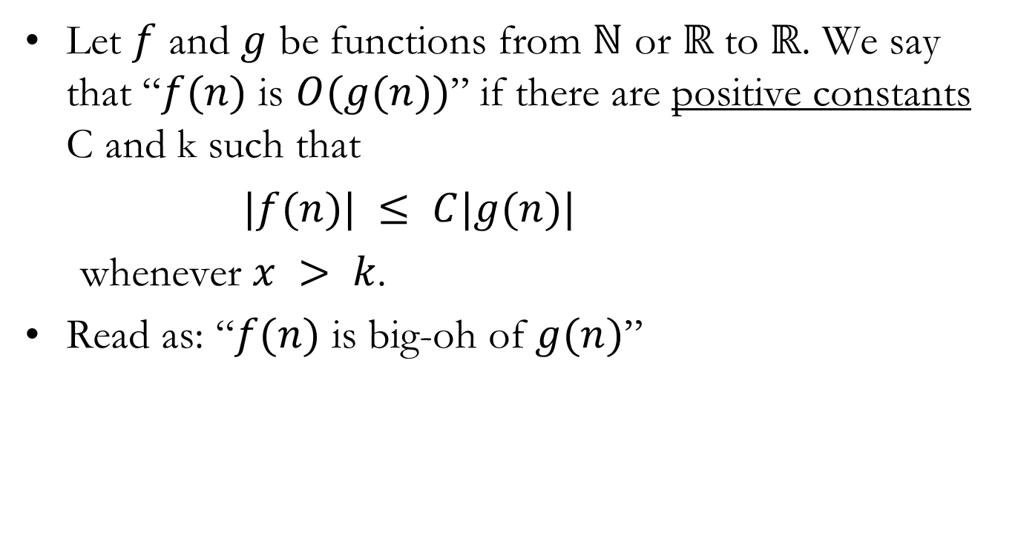
Big-O
Let $f$ and $g$ be functions from $ℕ$ or $ℝ$ to $ℝ$. We say that “$f(n)$ is $O(g(n))$” if there are positive constants C and k such that
$|f(n)| ≤ C|g(n)|$
whenever $x > k$.
Read as: “$f(n)$ is big-oh of $g(n)$”
Notes:
If Algorithm A requires time proportional to f(n), we say that Algorithm A is said to be order f(n), which is denoted as O(f(n)).
The function f(n) is called the algorithm’s growth-rate function.
Because the notation uses the capital letter O to denote order, it is called the Big O notation.
If a problem of size n requires time that is directly proportional to n, the problem is O(n)—that is, order n. If the time requirement is directly proportional to n², the problem is O(n²), and so on.

Slide 14
Big-O
If Algorithm A requires time proportional to f(n), we say that Algorithm A is said to be order f(n), which is denoted as O(f(n)).
The function f(n) is called the algorithm’s growth-rate function.
If a problem of size n requires time that is directly proportional to n, the problem is O(n)—that is, order n. If the time requirement is directly proportional to n², the problem is O(n²), and so on.

Slide 15
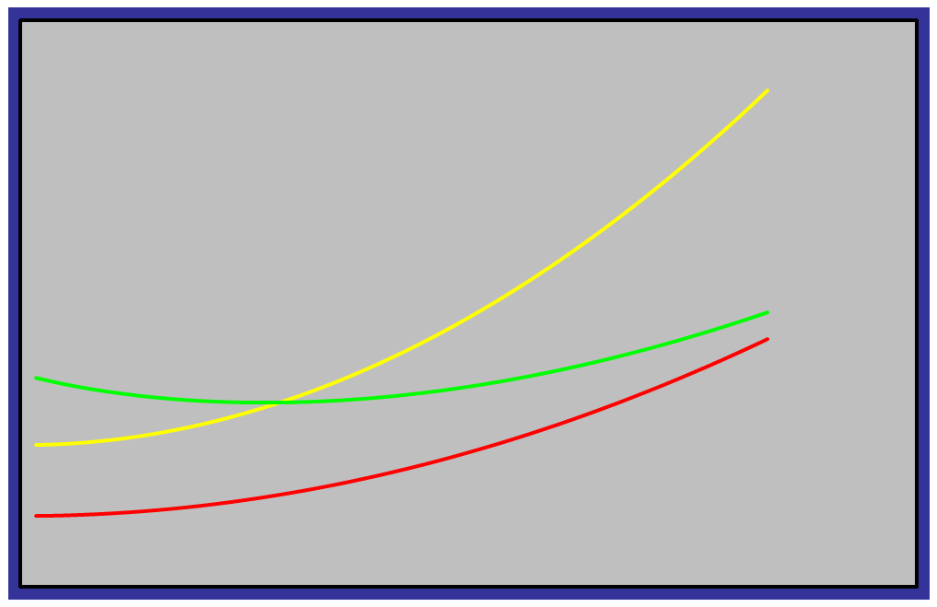
Big-O
C g(n)
f(n)
g(n)
x
k

Slide 16
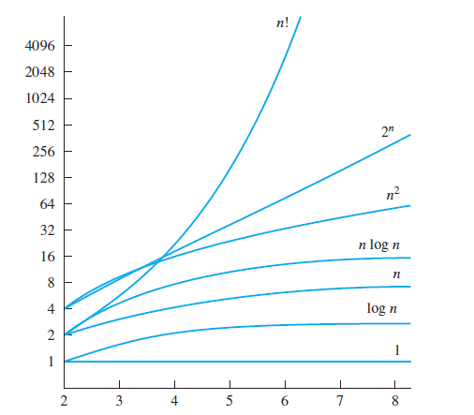
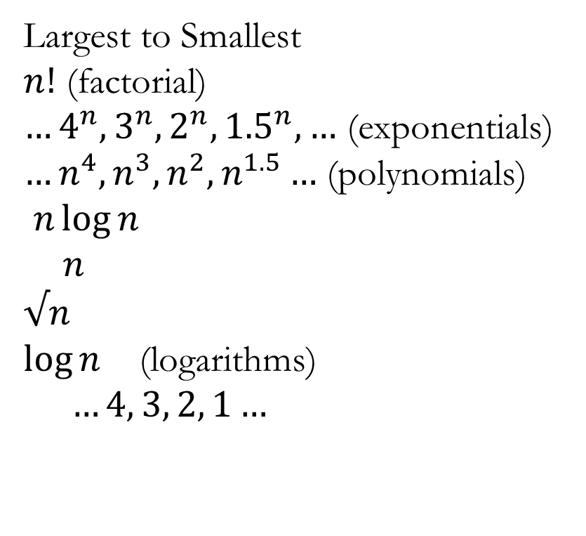
Growth Rates
Largest to Smallest
$n!$ (factorial)
$…4^{n}, 3^{n}, 2^{n}, {1.5}^{n}, …$ (exponentials)
$…n^{4}, n^{3}, n^{2}, n^{1.5}…$ (polynomials)
$n\log{n}$
$n$
$√n$
$\log{n}$ (logarithms)
$…4, 3, 2, 1…$
Notes:
A growth-rate function of 1 implies a problem whose time requirement is constant and, therefore, independent of the problem’s size n.
log₂ n The time requirement for a logarithmic algorithm increases slowly as the problem size increases. If you square the problem size, you only double its time requirement.
n The time requirement for a linear algorithm increases directly with the size of the problem. If you square the problem size, you also square its time requirement.
n log₂ n The time requirement for an n log₂ n algorithm increases more rapidly than a linear algorithm. Such algorithms usually divide a problem into smaller problems that are each solved separately.
n² The time requirement for a quadratic algorithm increases rapidly with the size of the problem. Algorithms that use two nested loops are often quadratic. Such algorithms are practical only for small problems.
n³ The time requirement for a cubic algorithm increases more rapidly with the size of the problem that the time requirement for a quadratic algorithm. Algorithms that use three nested loops are often cubic, and are practical only for small problems.
2^{n} As the size of a problem increases, the time requirement for an exponential algorithm usually increases too rapidly to be practical.
n! As the size of a problem increases, the time requirement for an factorial algorithm usually increases too rapidly to be practical.

Slide 17
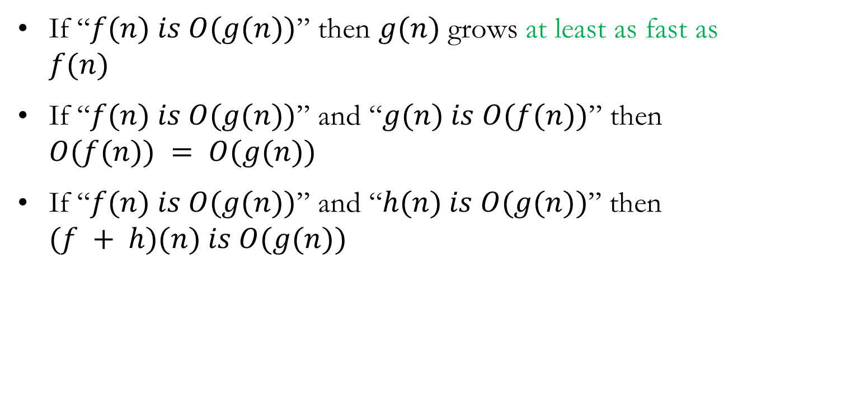
Properties of Big-O
If “$f(n) is O(g(n))$” then $g(n)$ grows at least as fast as $f(n)$
If “$f(n) is O(g(n))$” and “$g(n) is O(f(n))$” then $O(f(n)) = O(g(n))$
If “$f(n) is O(g(n))$” and “$h(n) is O(g(n))$” then $(f + h)(n) is O(g(n))$

Slide 18

Properties of Big-O (Cont..)
● If $a$ is a scalar and “$f(n) is O(g(n))$”, then $af(n)$ is $O(g(n))$
● If “$f(n) is O(g(n))$” and “$g(n) is O(h(n))$”, then $f(n) is O(h(n))$
Notes:
The term "scalar" comes from linear algebra, where it is used to differentiate a single number from a vector or matrix.
Upshot: Ignore constants

Slide 19
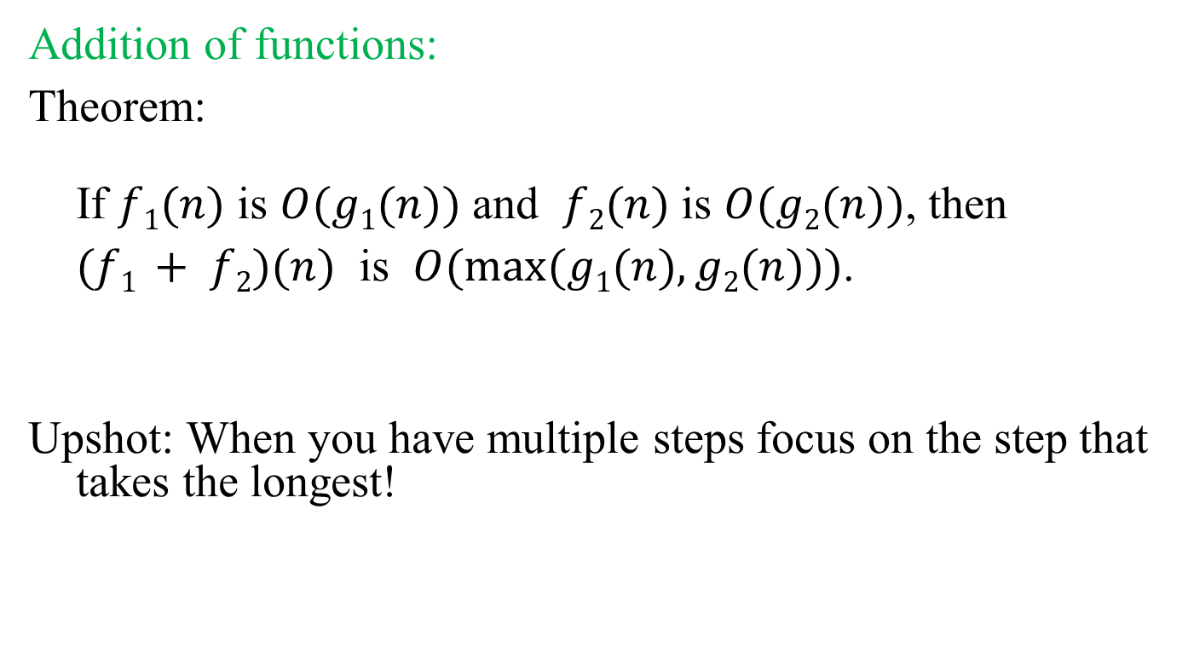
Growth of Combinations of Functions
Addition of functions:
Theorem:
If $f1(n)$ is $O(g1(n))$ and $f2(n)$ is $O(g2(n))$, then
$(f1 + f2)(n)$ is $O(max⁡(g1(n), g2(n)))$.
Upshot: When you have multiple steps focus on the step that takes the longest!
Notes:
If you have multiple steps

Slide 20
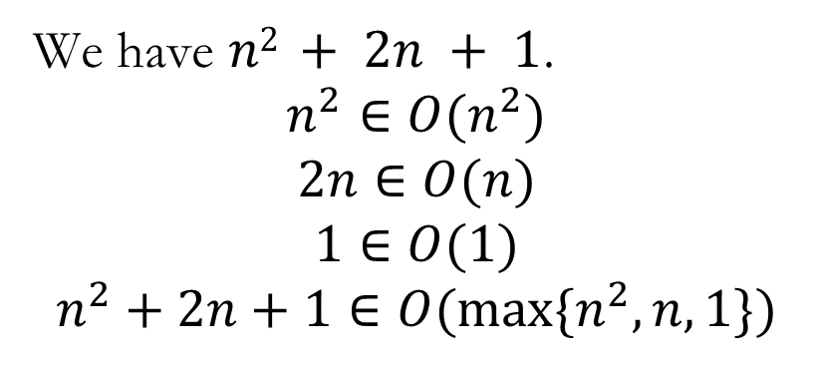
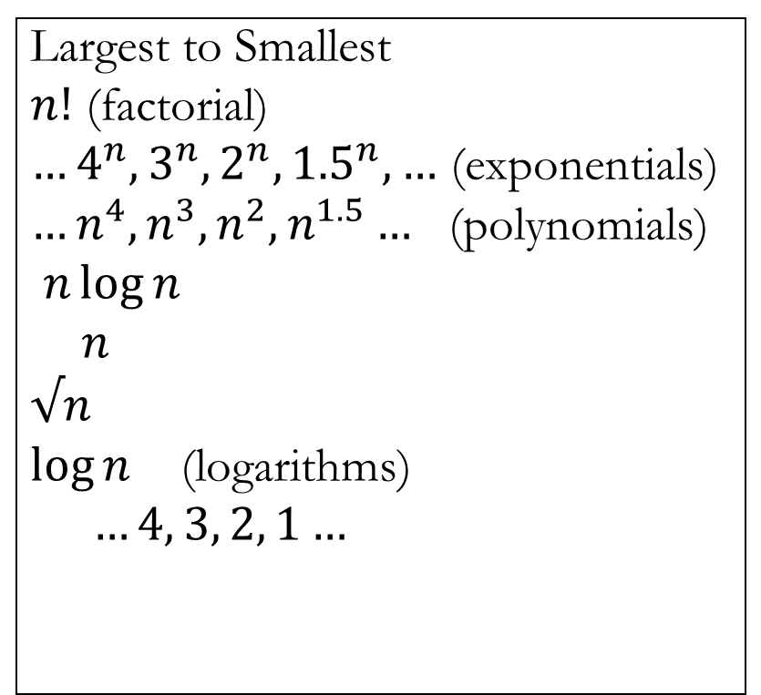
Example 1
for (int i = 0; i < n; i++)
for (int j = 0; j < n; j++) System.out.print(i * j);
for (int k = 0; k < n; k++) {
System.out.println(k);
System.out.println(k*k);
}
System.out.println(“Done”);
Largest to Smallest
$n!$ (factorial)
$…4^{n}, 3^{n}, 2^{n}, {1.5}^{n}, …$ (exponentials)
$…n^{4}, n^{3}, n^{2}, n^{1.5}…$ (polynomials)
$n\log{n}$
$n$
$√n$
$\log{n}$ (logarithms)
$…4, 3, 2, 1…$
We have $n2 + 2n + 1$.
$$n^{2}∈O(n^{2})$$
$$2n∈O(n)$$
$$1∈O(1)$$
$$n^{2}+2n+1∈O(\max{\{n^{2}, n, 1\}})$$
Notes:
Where would this come from
Double for loop
Single for loop with 2 operations
statement

Slide 21
Example 2
What is the complexity of the function?
$f(n) = 4n3 + 6 log⁡n+7n!$
We know that $4n3$ is $O(n3)$.
We know that $6 log⁡n$ is $O(log⁡n)$.
We know that $7n!$ is $O(n!)$.
Which is bigger, $O(n3)$ or $O(log⁡n)$ or $O(n!)$?
So $f(n)$ is $O(n!)$

Slide 22
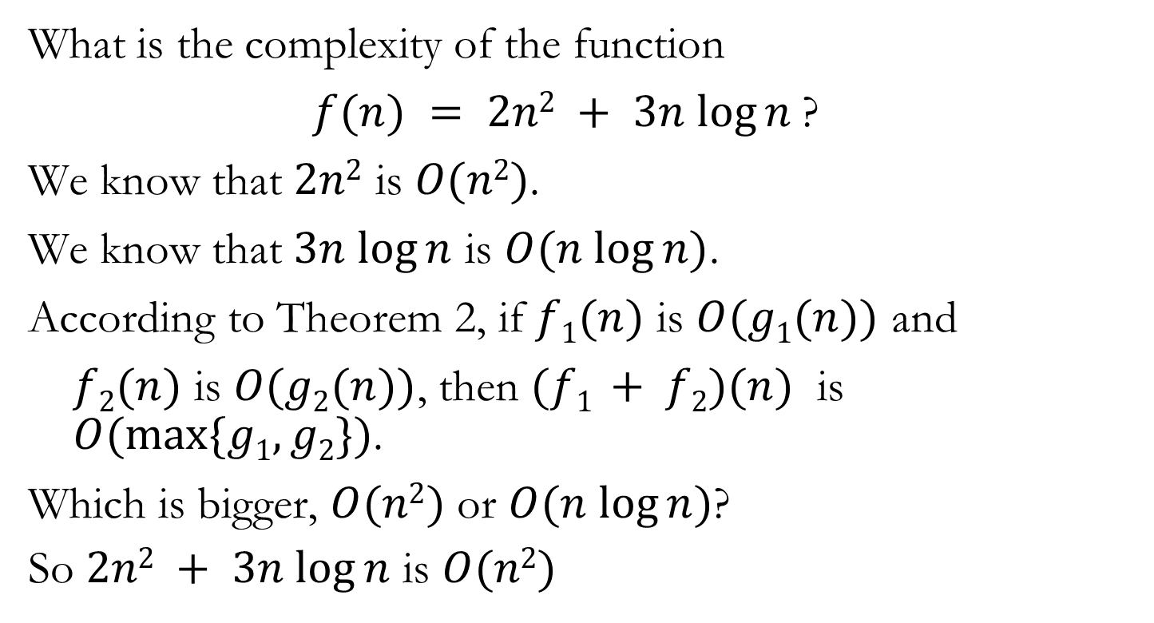
Example 3
What is the complexity of the function
$f(n) = 2n2 + 3n log⁡n$?
We know that $2n2$ is $O(n2)$.
We know that $3n log⁡n$ is $O(n log⁡n)$.
According to Theorem 2, if $f1(n)$ is $O(g1(n))$ and
$f2(n)$ is $O(g2(n))$, then $(f1 + f2)(n)$ is $O(max\{g1, g2\})$.
Which is bigger, $O(n2)$ or $O(n log⁡n)$?
So $2n2 + 3n log⁡n$ is $O(n2)$

Slide 23

Example 4
Show that $2n3 + 3n2 + 1$ is $O(???)$.

Slide 24

Growth of Combinations of Functions
Theorem 3:
If $f1(n)$ is $O(g1(n))$ and $f2(n)$ is $O(g2(n))$, then
$(f1f2)(n)$ is $O(g1(n)g2(n))$.
Upshot: When inside a subroutine, you do another subroutine, this has a multiplicative effect.
for (int i = 0; i < n; i++)
for (int j = 0; j < n; j++) DoThing();
public static void DoThing() {
for (int i = 0; i < n; i++)
System.out.println(“Thing”);
}

Slide 25
Example
What is the complexity of the function $f\left(n\right)= (2n+log n)(4n+3n\log{n})$ ?
The first term, $2n+log n$, is $O(n)$.
The second term, $4n+3n\log{n}$ is $O(n\log{n)}.$
So, $f(n)$ is $O(n⋅n\log{n}$) or $O(n^{2}\log{n})$.

Slide 26
Another Example
What is the complexity of the function $f\left(n\right)= (3n^{3}+n^{2}log n+6)(4n^{4}+3n\log{n+n^{6}})$?
The first term,$3n^{3}+n^{2}log n+6$, is $O(n^{3})$.
The second term,$4n^{4}+3n\log{n+n^{6}}$is $O(n^{6}).$
So, $f(n)$ is $O(n^{3}⋅n^{6}$) or $O(n^{9})$.

Slide 27
Example Algorithm
Consider our myArrayList implementation in Programming Assignment 03 using an array.
private void increaseArraySize() {
String[] newArray = new String[lstArray.length * 2];
for(int i = 0; i < newArray.length; i++)
newArray[i] = lstArray[i];
lstArray = newArray;
}
Notes:
Work on Board:
Let n be the length of lstArray. Adding a new element takes constant time, O(1), as long as the array is not full.
If the array is full, then the increaseArraySize() method is called which creates a new array twice as large (2n).
The new array is initialized to zero requiring 2n assignment operations.
The method then copies the contents of the old array into the new one in linear time, O(n).
Thus, the cost of increaseArraySize() is:
O(2n + n) = O(3n)
But, this call only occurs once every n add operations, so each call to add costs
[O(1) + O(1) + … + O(1) + O(3n)] / n = [O(n) + O(3n)] / n
= O(4n) / n
= O(n) / n
= O(1) amortized.

Slide 28

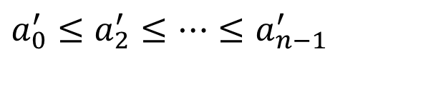

Example: Sorting
Formal definition of the sorting problem:
Input: A sequence of numbers
Output: A reordering
of the input sequence such that
$$\left\langle a_{0},a_{2},…,a_{n−1}\right\rangle$$
…
$$\left\langle a_{0}^{′},a_{2}^{′},…,a_{n−1}^{′}\right\rangle$$
…
$$a_{0}^{′}≤a_{2}^{′}≤…≤a_{n−1}^{′}$$

Slide 29
Bubble Sort
The simplest sorting algorithm that works by repeatedly swapping the adjacent elements if they are in wrong order:
Iterate through the array and compare adjacent items.
Swap them if the left item is larger than the right.
Iterate through again excluding the last item and compare adjacent items.
Swap them if the left item is larger than the right.
Continue.
Notes:
Example:
First Pass:
( 5 1 4 2 8 ) –> ( 1 5 4 2 8 ), Here, algorithm compares the first two elements, and swaps since 5 > 1.
( 1 5 4 2 8 ) –> ( 1 4 5 2 8 ), Swap since 5 > 4
( 1 4 5 2 8 ) –> ( 1 4 2 5 8 ), Swap since 5 > 2
( 1 4 2 5 8 ) –> ( 1 4 2 5 8 ), Since (8 > 5), algorithm does not swap them.
Second Pass:
( 1 4 2 5 8 ) –> ( 1 4 2 5 8 )
( 1 4 2 5 8 ) –> ( 1 2 4 5 8 ), Swap since 4 > 2
( 1 2 4 5 8 ) –> ( 1 2 4 5 8 )
( 1 2 4 5 8 ) –> ( 1 2 4 5 8 )
Now, the array is already sorted, but our algorithm does not know if it is completed. The algorithm needs one whole pass without any swap to know it is sorted.
Third Pass:
( 1 2 4 5 8 ) –> ( 1 2 4 5 8 )
( 1 2 4 5 8 ) –> ( 1 2 4 5 8 )
( 1 2 4 5 8 ) –> ( 1 2 4 5 8 )
( 1 2 4 5 8 ) –> ( 1 2 4 5 8 )

Slide 30
Bubble Sort
void bubbleSort(int arr[]) {
int n = arr.length;
for (int i = 0; i < n-1; i++)
for (int j = 0; j < n-i-1; j++)
if (arr[j] > arr[j+1])
{
// swap arr[j+1] and arr[j]
int temp = arr[j];
arr[j] = arr[j+1];
arr[j+1] = temp;
}
}

Slide 31
Bubble Sort
Example: Sort the list 3, 2, 4, 1, 5 into increasing order using the Bubble sort
3 2 4 1 5 | 2 3 4 1 5 | 2 3 4 1 5 | 2 3 1 4 5
2 3 1 4 5 | 2 3 1 4 5 | 2 1 3 4 5
2 1 3 4 5
1 2 3 4 5
1 2 3 4 5
1st pass
2nd pass
3rd pass
4th pass
= ordered
= interchange

Slide 32
Selection Sort
Iterate through the array and choose the largest valued item.
Put it in the last position.
Iterate through the array (excluding the last position) and choose the largest value.
Put it in the next to last position.
Continue.
Notes:
Example: 5 1 4 8 2

Slide 33
Insertion Sort
void sort(int arr[])
{
int n = arr.length;
for (int i = 1; i < n; ++i) {
int key = arr[i];
int j = i - 1;
/* Move elements of arr[0..i-1], that are
greater than key, to one position ahead
of their current position */
while (j >= 0 && arr[j] > key) {
arr[j + 1] = arr[j];
j = j - 1;
}
arr[j + 1] = key;
}
}
Notes:
Example: 5 1 4 8 2

Slide 34
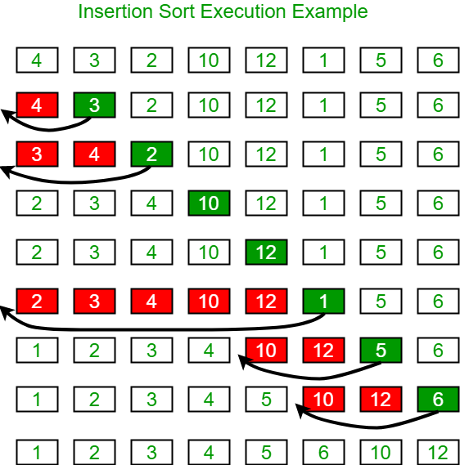
Insertion Sort
Notes:
Example: 5 1 4 8 2

Slide 35
Quick Sort
Choose pivot (at random index or last index).
If random index, swap with last index.
Set ‘left’ to first index that is larger than swap.
Set ‘right’ to first index from right that is smaller than swap.
Swap these two items.
From that left and right position, continue scan and repeat swaps until left > right.
Swap left and last.
Recursive call on left array (0 to left – 1) and recursive call on right array (left + 1 to last).
Notes:
Example: 5 1 4 8 2

Slide 36
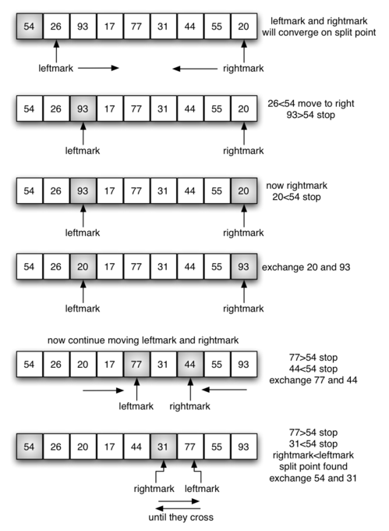
Quick Sort
Notes:
Example: 5 1 4 8 2

Slide 37
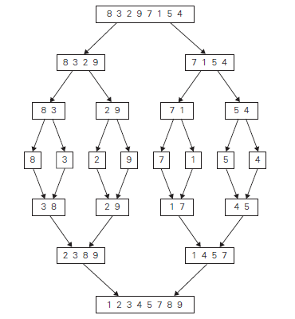
Merge Sort
Recursive Algorithm where the area is divided and then sorted areas are merged.
Work from sorted arrays
Merge them using the fact they are sorted.

Slide 38
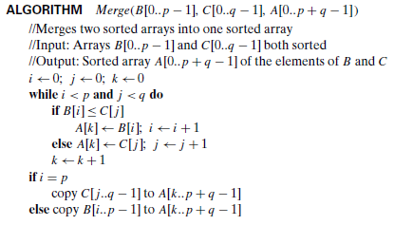
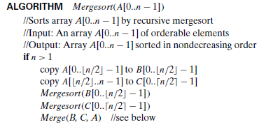
Merge Sort
We have multiple algorithms for the same problem. How do we tell which is “better”?

Slide 39
Example of Time efficiency
 | Worst case | Average case
Selection sort | O(n²) | O(n²)
Bubble sort | O(n²) | O(n²)
Insertion sort | O(n²) | O(n²)
Mergesort | O(n log n) | O(n log n)
Quicksort | O(n²) | O(n log n)

Slide 40
Example of Time efficiency
n | O(n²) | O(n log n)
4 | 16 | 8
8 | 64 | 24
16 | 256 | 64
32 | 1024 | 160
64 | 4096 | 384
128 | 16,394 | 896
256 | 65,536 | 2048
512 | 262,144 | 4608
1024 | 1,048,576 | 10,240
1,048,576 | ~1,000,000,000,000 | 20,971,520

Slide 41
Summary
Best is mergesort in terms of time efficiency
Worst are selection sort, bubble sort, and insertion sort.
But all three are ‘good enough’ on small data sets.
Radix sort and Distribution Counting Sort are only good if the set of possible values is small.
Not good for double or String.
Good for char or small range of int (e.g., -100 to 100).
In practice, quicksort is better than mergesort, because quicksort is an “in-place” sorting algorithm whereas mergesort has the overhead of method calls an extra memory requirements.

